Slide 1


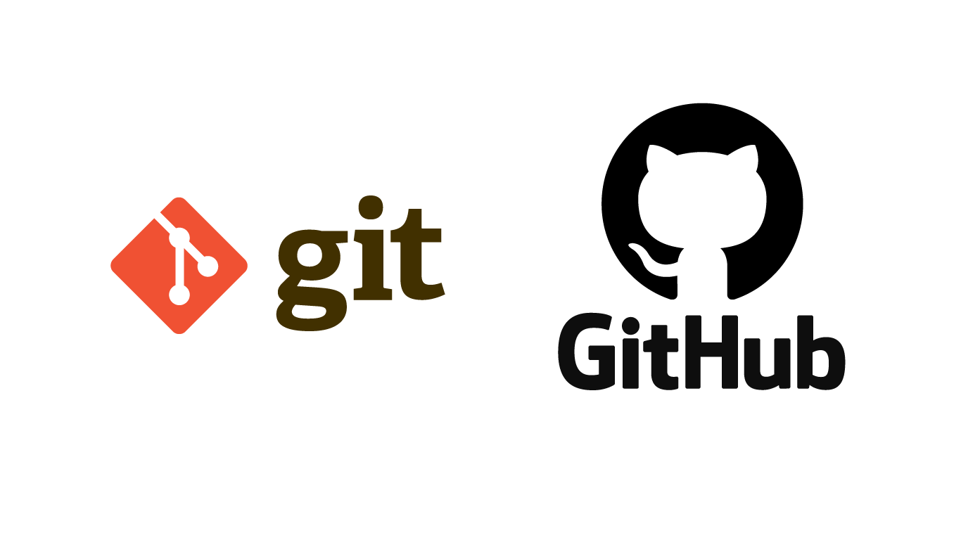



Git & GitHub

Slide 2

Version control systems
Version control (or revision control, or source control) is all about managing multiple versions of documents, programs, web sites, etc.
Almost all “real” projects use some kind of version control
Essential for team projects, but also very useful for individual projects
Its like a “central” repository; users “check out” files, work on them, and “check them in”

Slide 3
Why version control?
For working by yourself:
Gives you a “time machine” for going back to earlier versions
Gives you great support for different versions (standalone, web app, etc.) of the same basic project
For working with others:
Greatly simplifies concurrent work, merging changes

Slide 4
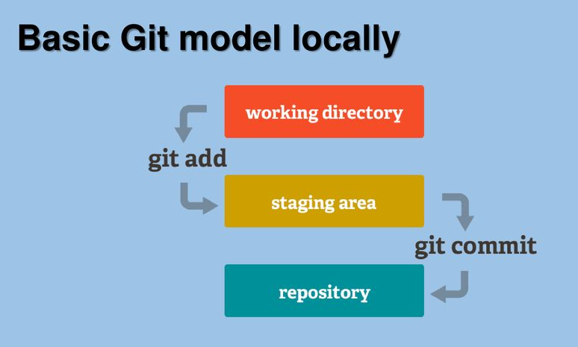
Git model Locally

Slide 5
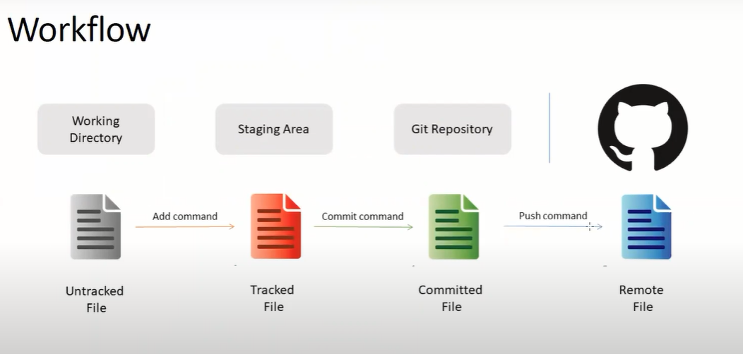

Slide 6
1. Create local git repository for your working project:
git init ----> It will create empty git repository (Local repository)
2. Now connect your git (local repo) with Github/BitBucket (global repo)
git remote add origin ENTER REOSITORY LINK HERE (eg: https://github.com/xyz/basicFramework.git)
now we have to provide your identity (only 1st time - one time)
git config --global user.name “enter username"
git config --global user.email “enter mail id"
3. To check the status of tracked and untracked file
git status
4. Then add all our codes in staging area which we want to commit in remote
git add -A
5. Again check the status after adding code in staging area
git status
6. Now commit out code in git repository (local repo)
git commit -m "first commit" (some msg, you can provide any message here)
7. Check git status again to check the current status
git status
8. Push the code from git --> GitHub (Local Repo -> Remote Repo)
git push -u origin master
Enter username and password if prompting

Slide 7
Now you can clone URL or anyone can download the codes from GitHub directly
9. Create a new file in directly in GitHub and then pull the new changes
git pull
10. Now update file in your working copy and check the status again
git status
11. Again add in staging area
git add -A
12. Then commit in GitHub again
git commit -m "second commit"
13. Push the code from git --> GitHub (Local Repo -> Remote Repo)
git push -u origin master
Enter username and password if prompting
14. Check the status again to confirm the current status
git status
Download git command text file from below

Slide 8
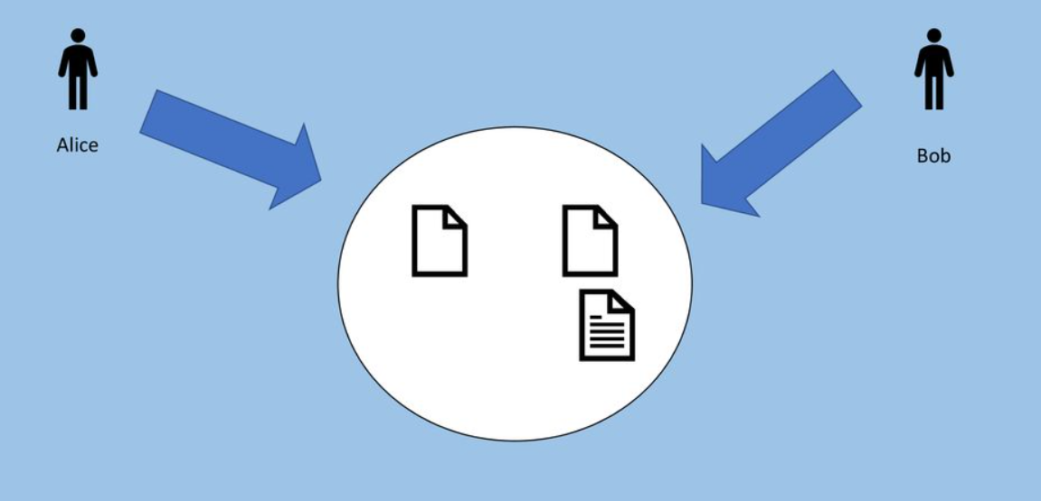

Slide 9
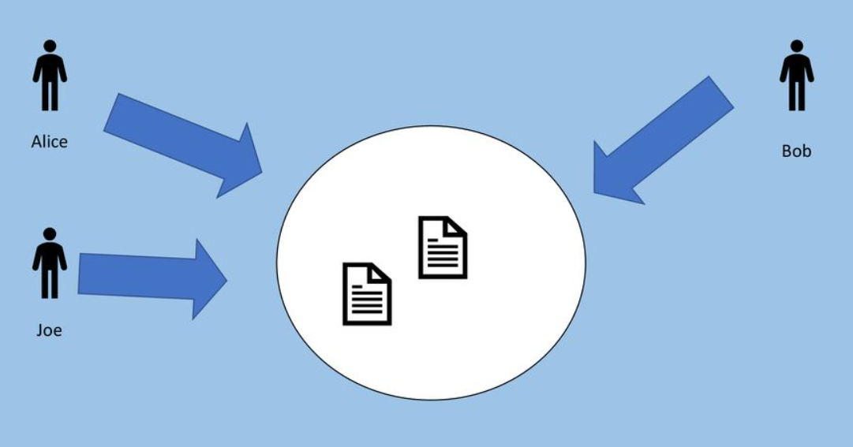

Slide 10
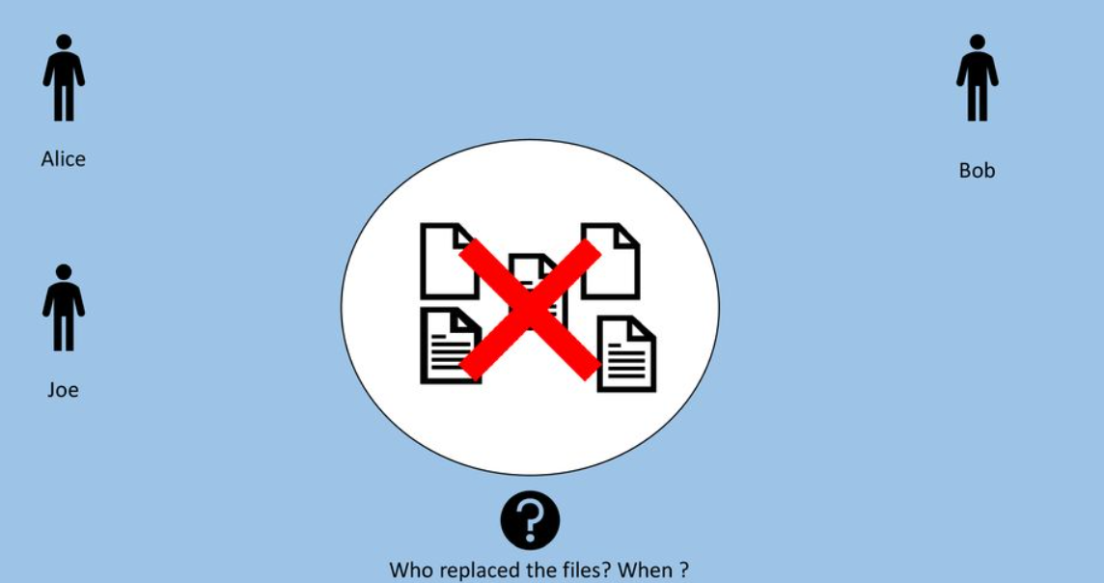

Slide 11
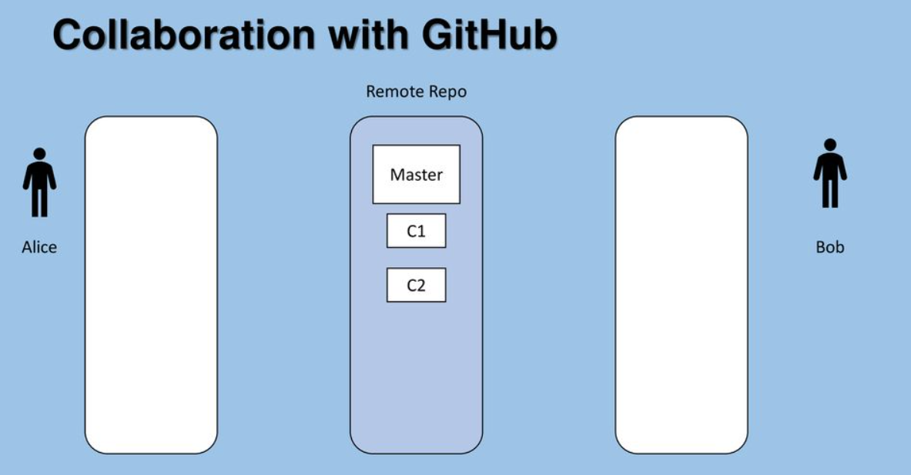

Slide 12
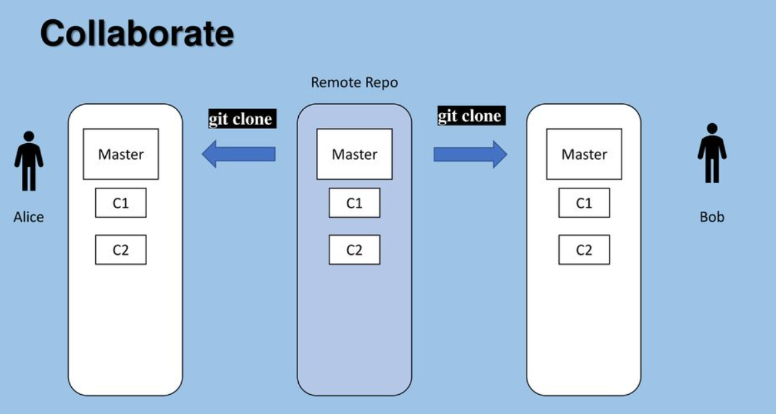

Slide 13
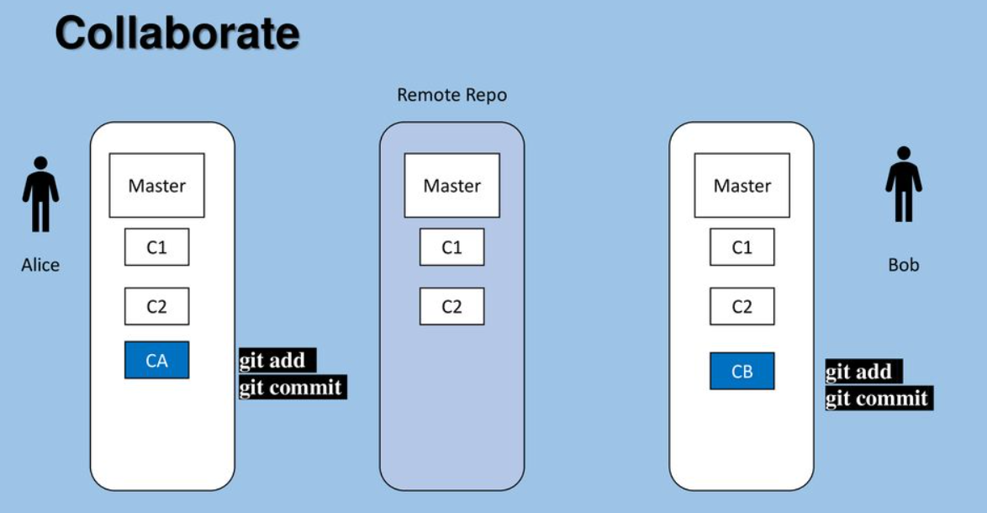

Slide 14
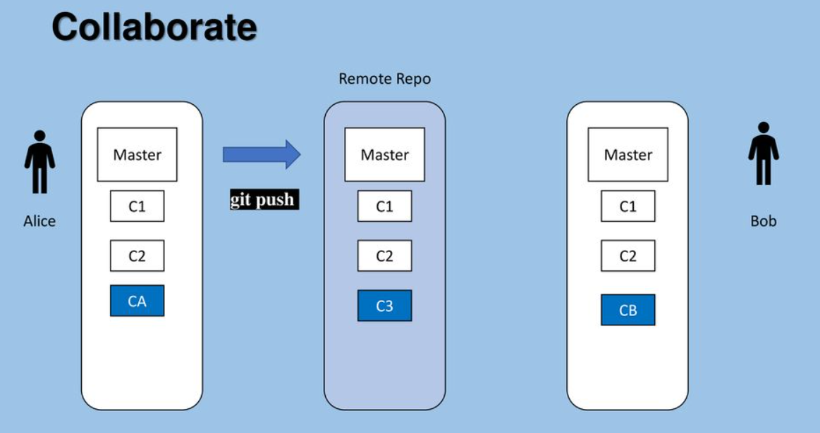

Slide 16
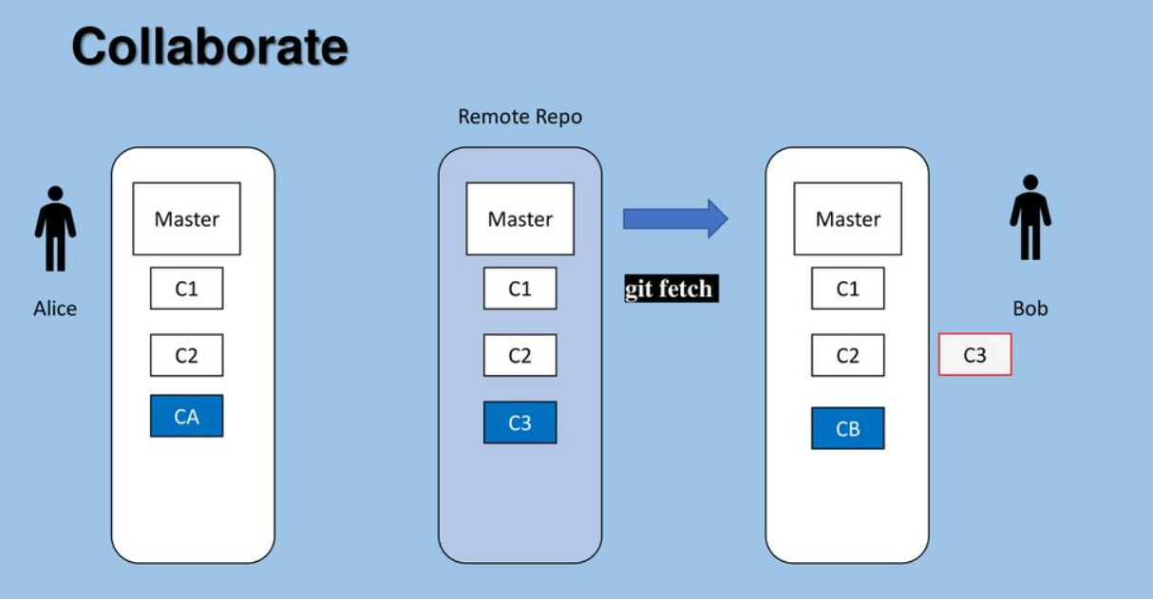

Slide 17
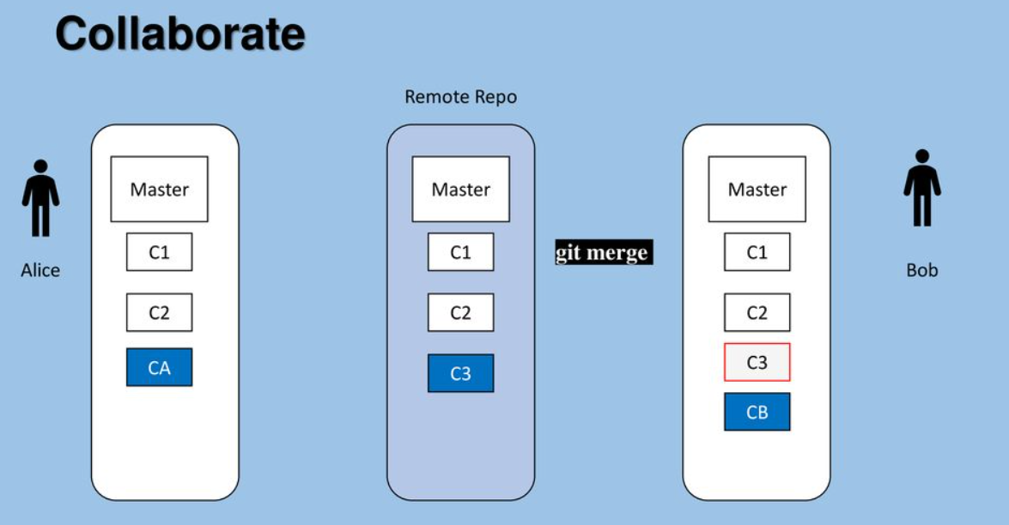

Slide 18
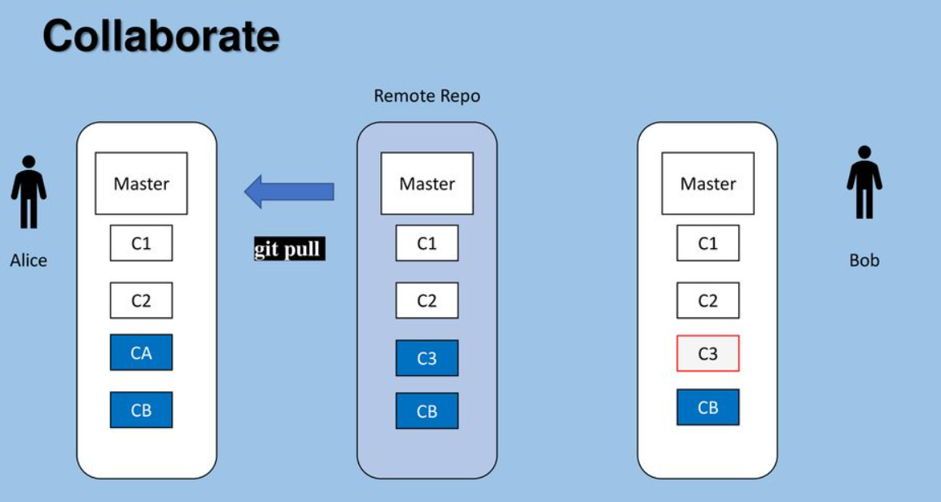

Slide 19
Thank You

